Slide 1
CprE 530
Lecture 24

Slide 2
Topics
Anonymous services
  Routing
  Surfing
Privacy on the Internet
Proxy servers
General countermeasures

Slide 3
Email Tracking
www.readnotify.com
Uses web bug tracking
Keeps a log and emails you when the recipient opens the email.
Looks like the email came from the sender, you send the email to:
  user@domain.readnotify.com

Slide 4
Anonymous Email Services
Login to a web site and send email from the site.
Gmail, etc.
Special sites for anonymous email
  www.anonymousspeech.com

Slide 5
Privacy surfing the Internet
Web servers can collect demographics about you
www.privacy.net will show you all the things a webserver knows about you
Examples:
  Your browser type and Operating System
  CPU type
  whether JavaScript is enabled
  Date/Time on your computer
  Your IP address
  Which plugins you have installed

Slide 6
Privacy on the Internet
Once you login and give your email address, you are no longer anonymous
Some web sites share your email address with other sites
This can lead to you receiving spam from sites to which you’ve never disclosed your email
Some sites store cookies on your harddrive. Amazon.com does this to recommend books based on your previous purchases.
One way to surf privately: connect through a proxy

Slide 7
Proxy Servers
A proxy is basically someone who makes requests on your behalf
They were originally designed to cache information to prevent redundancy
Suppose you (M) want to view a web page from server W. Here’s how it would look without a proxy:
SIP = M S Port = ephemeral
DIP = W D Port = 80
URL=http://w.com/path
Notes:
SIP = Source IP
DIP = Destination IP
S Port = Source port (varies)

Slide 8
Proxy Servers
Here’s how it would look if you used a proxy server. Two different packets are needed: packet A is generated by yourself, and packet B is generated by the proxy server
Packet A: Packet B:
  SIP=M SPort=? SIP=P SPort=?
  DIP=P DPort= DIP=W Dport=80
  URL=http://w.com/path URL=http://w.com/path
A
B
Proxy Server
M
W

Slide 9
Proxy Servers
There are two reasons to be anonymous
  Don’t want webservers to know who we are
  Don’t want big brother (ie: your boss) to know what sites we are visiting
A proxy can provide some amount of anonymity
Examples of existing proxy servers used to provide anonymity:
  anonymizer.com, safeweb.com, kaxy.com, the-cloak.com
However, if your company does not wish you to be using these proxies, they can block access to them through their firewall.

Slide 10
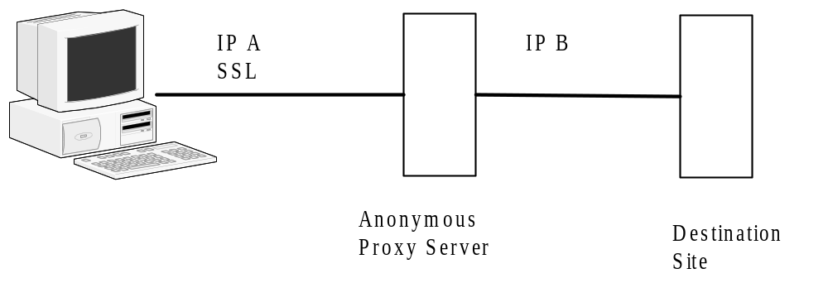
Secure Proxy Server

Slide 11
Proxy Servers
However, TOR has a fix that prevents a company from blocking access to their site.
It involves a a system called onion routing
See diagram next slide

Slide 12
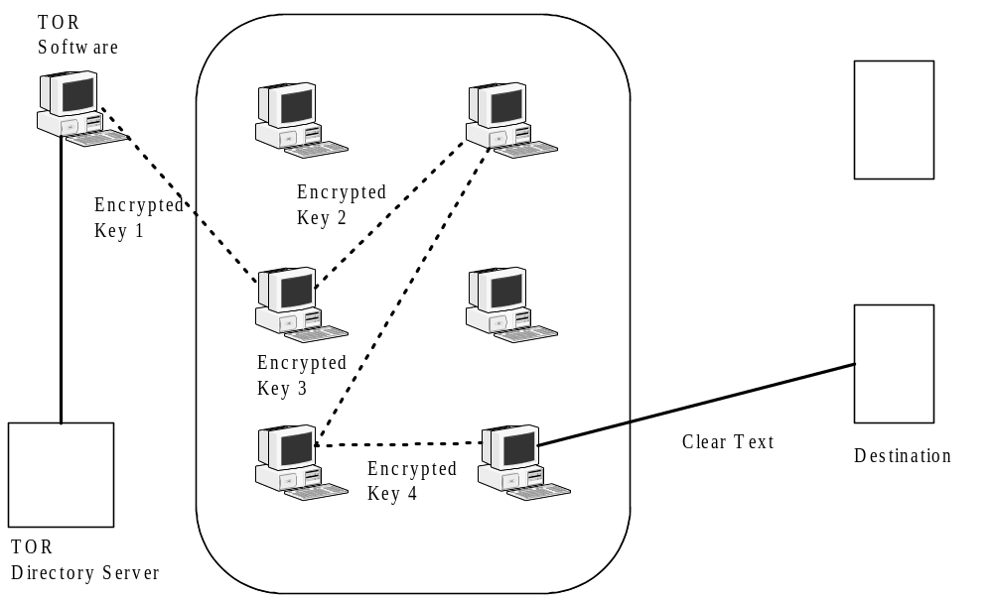
TOR

Slide 13
TOR
Starting host builds the connection one node at a time.
The encryption keys are between each node and the starting point, so each node is unable to read the data
Once the end node is reached the starting node has a key with each node.
Destination host only sees the last node

Slide 14
Security Issues
Bypass company security policies
Hard to stop

Slide 15
General Countermeasures
Encrypted remote access
  Application-based
  Tunnel-based
  SSH
  Remote desktop
  Secure File transfer

Slide 16
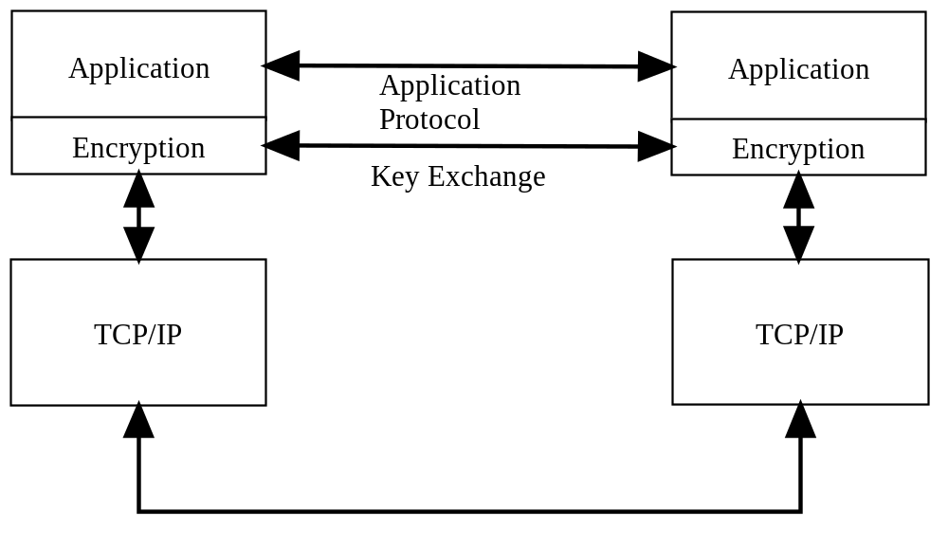
Application-Based Encryption

Slide 17
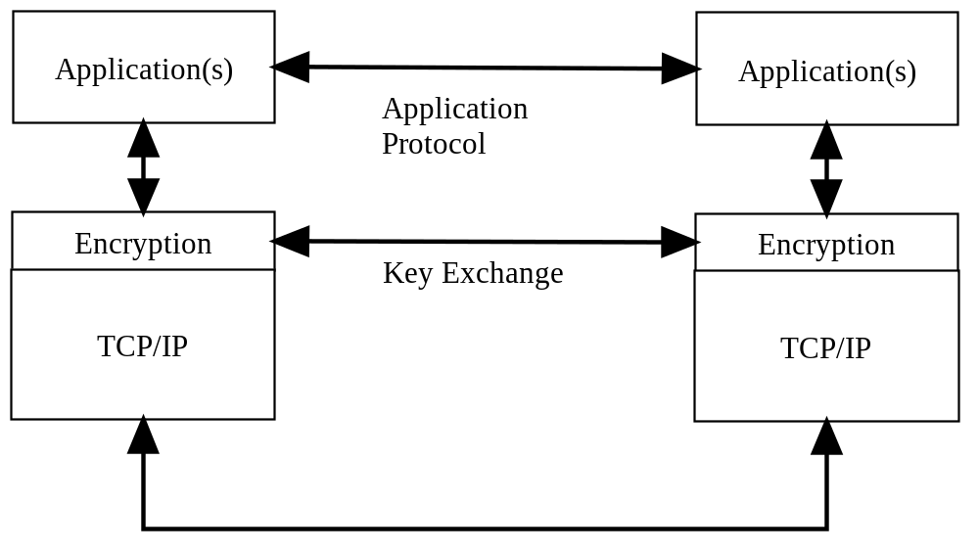
Tunnel-Based Encryption

Slide 18
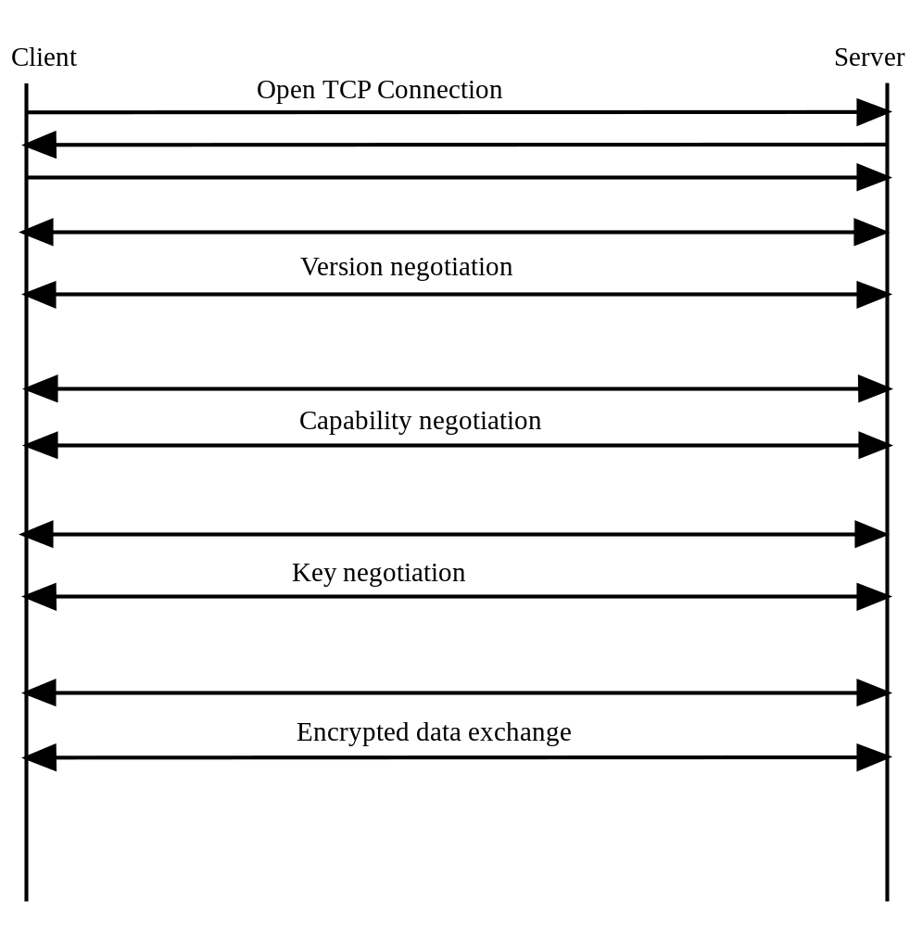
Encrypted Remote access protocols

Slide 19
SSH
SSH
  Secure shell
  Designed to replace rlogin, rsh, rcp
  Provides
    Authentication at the machine level, doesn’t care about user authentication
    Secure communication through encryption

Slide 20
SSH Details
Strong Authentication
Public domain software
Some versions support compression of data
Privacy
  Key negotiation with symmetric key
  Key exchange based on no trust of network
  Multiple keys to deal with replay attacks
Can provide secure X11 sessions
Encrypt any traffic with SSH
Same parameters as rlogin
If other side doesn’t support SSH drops to rlogin

Slide 21
Details cont…
Need server and client software
Sshd server demon software
Ssh is the client software
Ssh keygen
  Generates host key
Ssh agent
  Uses public and private key technique to get process started

Slide 22
SSH Protocol
Client sends query
Server sends two public keys which is a 1024 bit client key and a server key which is a 768 bit key
Server key recomputed every hour
Client generates 256 bit random number which is the symmetric key, which is encrypted using the server and the host keys
Server responds with ok which is encrypted with session key
All traffic is now encrypted with session key
Problems
  Man in the middle attack
  Putty is a man in the middle attack program

Slide 23
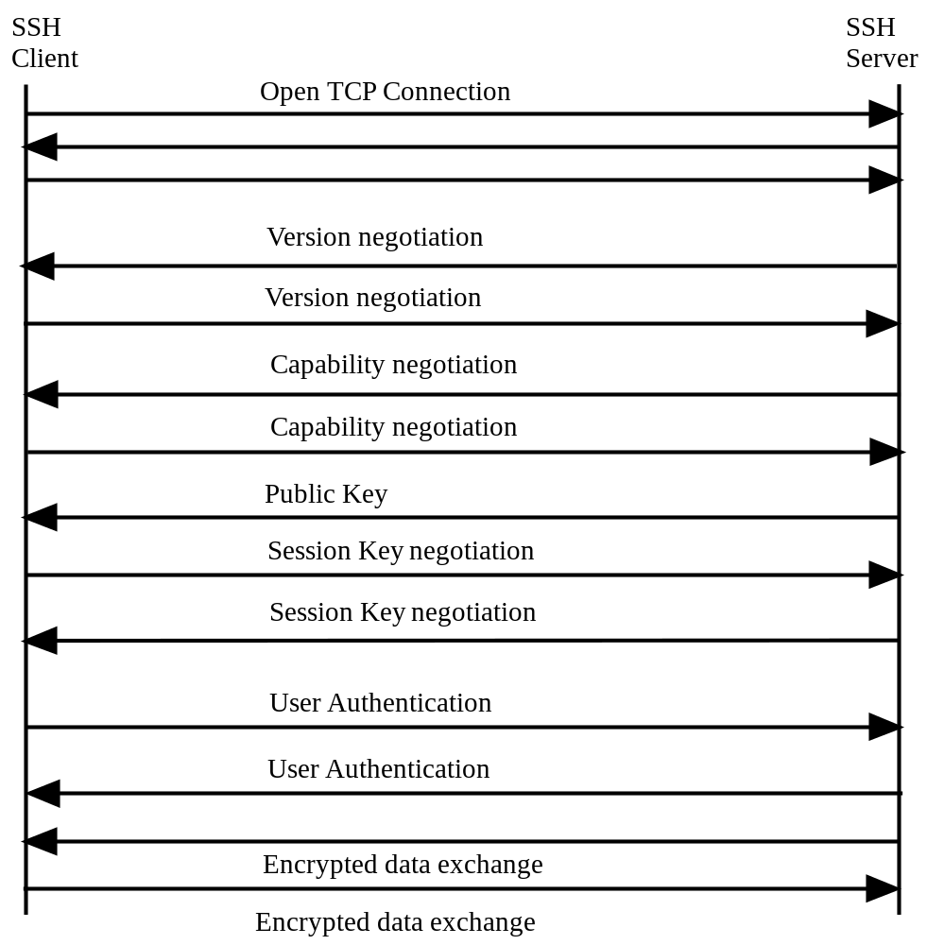
SSH

Slide 24
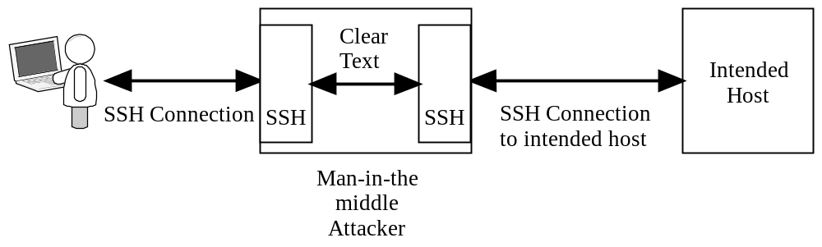
SSH Man in the Middle Attack

Slide 25
Remote Desktop
Uses tunnel-based encryption
  Via RDP or TLS (newer versions)
Key exchange is similar to SSH
Three levels
  High (128 bit)
  Medium (56 or 40 bit)
  Low (56 or 40) only client to server data
Subject to password guessing and man in the middle attacks

Slide 26
Secure File Transfer
SFTP – uses SSH
FTPS – uses SSL/TLS
HTTPS – uses SSL/TLS

